Slide 1

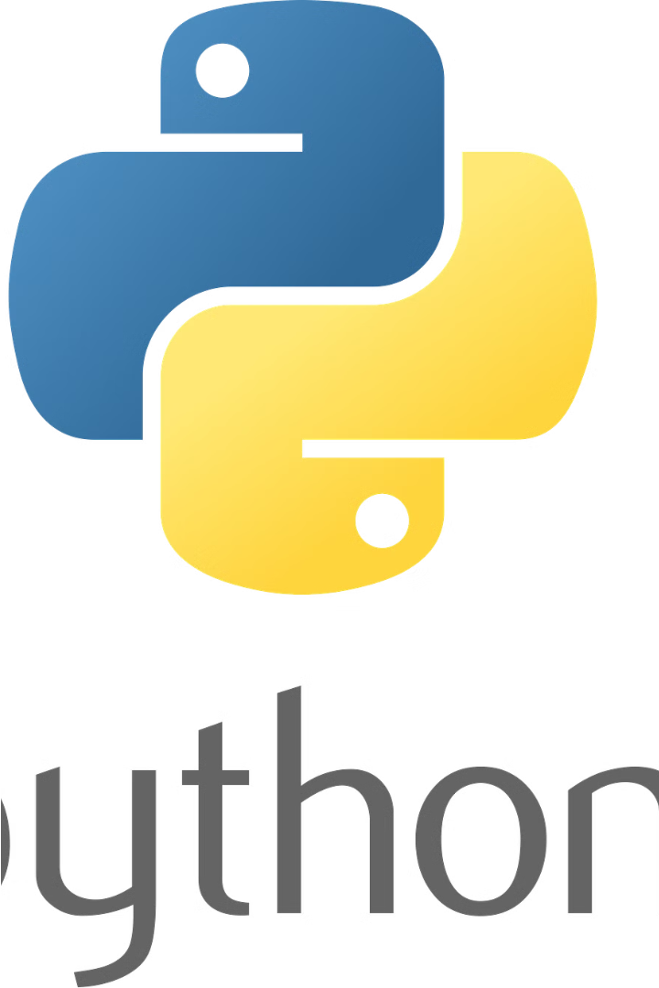
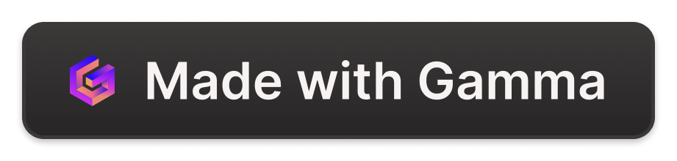
Introduction to Python
Python is a powerful, versatile, and high-level programming language that is widely used for a variety of applications, from web development and data analysis to artificial intelligence and scientific computing. It is known for its simplicity, readability, and ease of use, making it an excellent choice for beginners and experienced programmers alike.

Slide 2

History of Python
Python was created in the late 1980s by Guido van Rossum, a Dutch programmer, who wanted to develop a language that was more readable and concise than existing options. Python was first released in 1991 and has since grown to become one of the most popular programming languages in the world, with a large and active community of developers.

Slide 3

Python Syntax and Data Types
Syntax
Data Types
Dynamic Typing
Python has a clean and straightforward syntax, using indentation to define code blocks instead of curly braces or other punctuation. This makes the code more readable and easier to write and understand.
Python supports a wide range of data types, including integers, floats, strings, booleans, lists, tuples, dictionaries, and sets. These data types allow developers to work with a variety of data and create complex applications.
Python is a dynamically typed language, which means that variables can hold values of any data type without explicit declaration. This makes the language more flexible and easier to use, but also requires developers to be more careful in their coding practices.

Slide 4
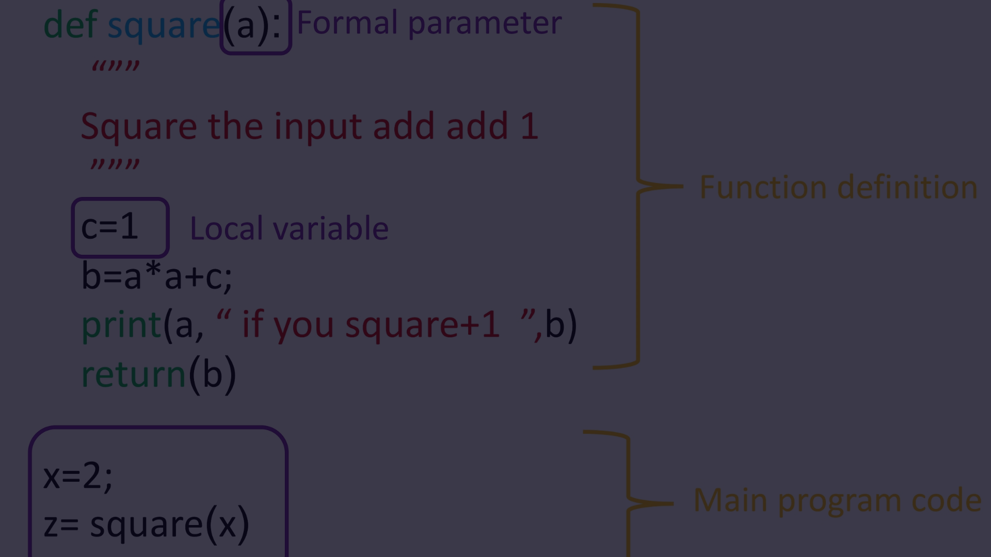
Python Functions
Definition
Recursion
Functions in Python are reusable blocks of code that perform a specific task. They can take arguments, perform operations, and return values.
Python functions can also be recursive, where a function calls itself to solve a problem. This can be a powerful technique for solving complex problems.
1
2
3
Scope
Functions have their own scope, which means that variables defined within a function are only accessible within that function, unless they are explicitly returned or passed as arguments.

Slide 5
Python Modules and Packages
1
Modules
2
Packages
Python modules are files containing Python code that can be imported and used in other Python scripts. This allows for code reuse and modular programming.
Python packages are collections of related modules that are organized into directories. This helps to structure and manage large Python projects.
3
Standard Library
4
Third-Party Packages
Python comes with a vast standard library that provides a wide range of functionality, from file I/O to regular expressions, without the need to install additional packages.
In addition to the standard library, Python has a rich ecosystem of third-party packages that can be installed to extend the language's capabilities even further.

Slide 6
Python Standard Library
os
sys
The os module provides a way to interact with the operating system, allowing you to perform tasks such as creating, deleting, and renaming files and directories.
The sys module provides access to some variables used or maintained by the interpreter and to functions that interact strongly with the interpreter.
math
datetime
The math module provides access to the mathematical functions defined by the C standard, including trigonometric, exponential, and logarithmic functions.
The datetime module provides classes for working with dates and times, including calendars, time zones, and time intervals.

Slide 7




Advantages and Use Cases of Python
Simplicity
Versatility
Large Community
Open Source
Python's simple and readable syntax makes it easy to learn and use, especially for beginners.
Python can be used for a wide range of applications, from web development and data analysis to machine learning and artificial intelligence.
Python has a large and active community of developers who contribute to its growth and development, providing a wealth of resources and support.
Python is an open-source language, which means that its source code is freely available and can be modified and distributed by anyone.

Slide 8
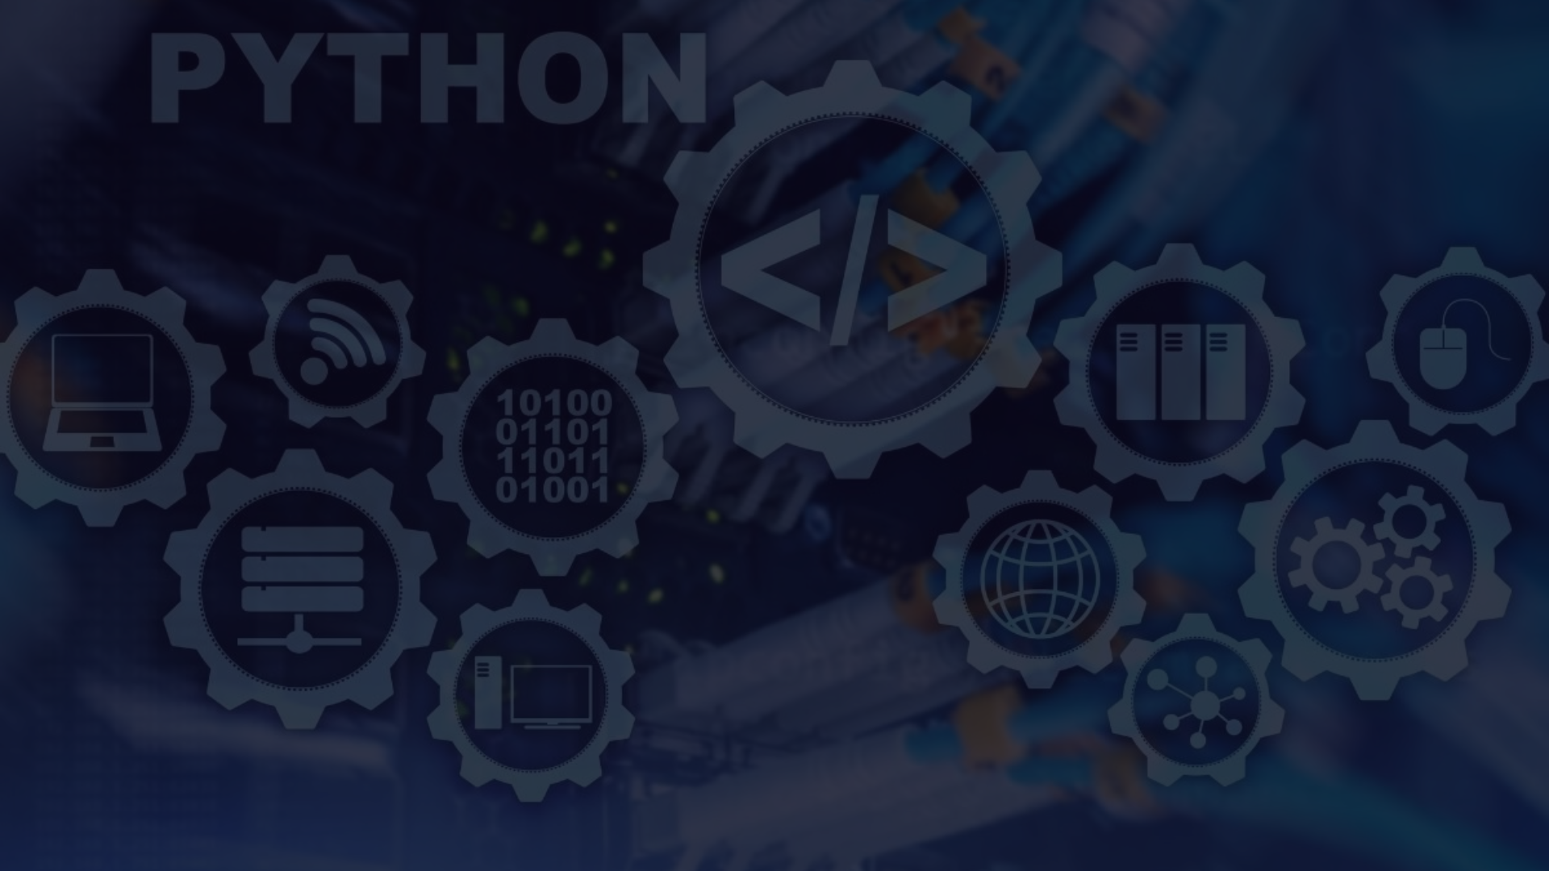



Future of Python
Continued Growth
Language Improvements
Increased Adoption
Python is expected to continue growing in popularity and usage, with a strong focus on areas like data science, machine learning, and artificial intelligence.
As Python becomes more widely used in both industry and academia, its adoption is expected to continue increasing, leading to more opportunities for developers and users alike.
The Python community is constantly working to improve the language, with new features and enhancements being added regularly to address user needs and emerging technologies.

